Slide 1

Orgs and Spaces

Slide 2
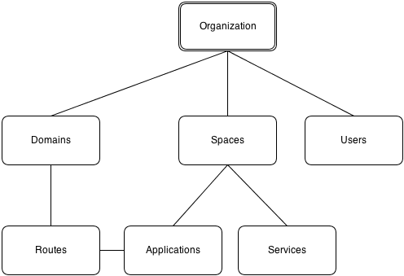
Notes:
goal:
single platform for all devices
Increase quality and reduce the amount of stabilization
reduce planning.
PaaS is good fit for Project automatization
tests should be small.

Slide 3
Organization
Top-most meta object within the Cloud Foundry organizational structure
Has 1 to many Spaces
Has 1 to many Users
Has 0 to many Domains
Can be suspended
Available user roles:
Org Managers: users who need to administer the org.
Org Auditors: view but cannot edit user information and org quota usage information.
Org Billing Managers: create and manage billing account and payment information.
Notes:
goal:
single platform for all devices
Increase quality and reduce the amount of stabilization
reduce planning.
PaaS is good fit for Project automatization
tests should be small.

Slide 4
Spaces
Second-level meta object within the Cloud Foundry organizational structure
A convenient way to separate environments in one CF deployment
Has 0 to many Applications
Has 0 to many Services
Available user roles:
Space Managers: users who administer a space within an org.
Space Developers: users who manage applications and services in a space.
Space Auditors: view but cannot edit the space.
Notes:
goal:
single platform for all devices
Increase quality and reduce the amount of stabilization
reduce planning.
PaaS is good fit for Project automatization
tests should be small.

